Slide 1
KP GoDiab
Design Sprint
Product Manager: Khushbu Gupta
© 2019 Udacity. All rights reserved.

Slide 2
Set the stage
Set the stage for the Design Sprint by framing the problem
© 2019 Udacity. All rights reserved.
Notes:
[ALL PARTICIPATION]

Slide 3

Initial PRD
Link your PRD

Slide 4
Understand
Create a shared understanding of the space, problem, and goals
© 2019 Udacity. All rights reserved.
Notes:
[ALL PARTICIPATION]

Slide 5
How Might We
Use these digital stickies to capture your ideas. Feel free to rearrange. Colorize. Etc
How might we provide patient health data ?
How might we know patient health is improving?
How might we notify patient family member for any emergency ?
How might we tell patients for any risk factors?
How might we recommend patient medicine?
How might we check patients energy level
How might we know patient’s insulin level ?
How might we enable user to share their personalized plan with others?
How might we change the patient lifestyle ?
How might we provide patient health care consultation?
How might we keep patient motivated ?
How might we provide 24*7 assistance to patient ?
How might we resolve patient doubts?
How might we track patient’s diet ?
How might we track the patient’s physical activity ?
How might we create personalized diet plan for user?
How might we recommend diet food to patient ?
How might we recommend what physical activity patient can do ?
How might we track how much weight patient has lost?
How might we know patient glucose level ?

Slide 6
Other stickies 1
How might we help people make more healthy food choices?
How might we allow users to share health choices with friends?
How might we allow users to compare choices vs. norms?
How do we convince people to exercise regularly?
How do we teach patients how to mediate?
How might we build good habits at a young age?
How might we facilitate conversations about health habits between patients and care providers?
How might we make it easier for patients to get exercise?
How might we notify patients when they are making a suboptimal food choice?
How might we help patients stop smoking?
How might we track a patient's physical activity?
How might we make health data easier for patients to understand?
How might we reward healthy behavior choices?
How might we reward people when they learn about better health choices?
How might we connect people to health information?
How might we help a patient track their food choices?
How might we help people find accountability partners?
How might we get people to drink more water?

Slide 7
Other stickies 2
How might we get people to build healthier habits?
How might we gamify healthy habits?
How might we create a rewards system?
How might we help patients monitor their goals?
How might we help patients set health goals?
How might we allow people to better understand their health?
How might we make people aware of risk factors?
How might we identify and warn pre-diabetic patients
How might we prevent patients from making unhealthy choices?
How might we raise awareness across society?
How might we build a social support system?
How might we promote health habits?
How might we help people better understand diabetes?
How might we encourage people to drink more water?
How might we get people to walk 30 minutes every day?
How might we make people aware of their current state of health?

Slide 8
Other stickies 3
How might we create a personalized plan?
How might we warn users about unhealthy choices?
How might we make healthy food choices accessible?
How might we make healthy food choices affordable?
How might we encourage goals patients already are trying to make?
How might we use ubiquitous technology to improve patient health?
How might we reward patients for eating more vegetables?
How might we identify healthy habits with the most benefit?
How might we make patients feel accountable?
How might we provide activity tracking?
How might we improve patient satisfaction and well being without increasing costs?
How might we educate our patients about healthy habits?
How might we help patients increase their physical activity?
How might we use ubiquitous technology to track patient data securely?
How might we allow people to better track their own health data?
How might we reduce sedentarism?
How might we incentivise exercise?
How might we reward patients for walking more?
How might we reward people for good behaviors?
How might we educate our patients about preventative health care?
How might we allow for safe and secure sharing of health data btw patient and caregiver.
How might we gamify health?
How might we.allow people to better access their medical records?
How might we gamify positive lifestyle changes?

Slide 9
External Factors to control diabetes
How do we teach patients how to mediate?
How might we help patients stop smoking?
How do we reduce a patient’s alcohol intake?
How do we reduce a patient’s alcohol intake?
How might we get people to drink more water?
How might we remind patient to drink water every hour ?
Meditation
Control smoking and alcohol
Good habits

Slide 10
Social Network for Patients
How might we connect people to health information?
How might we help people find accountability partners?
How might we raise awareness across society?
How might we enable user to share their personalized plan with others?
How might we notify patient family member for any emergency ?
How might we allow users to share health choices with friends?
How might we build a social support system?
How might we tell patients for any risk factors?
Networking with other patients
Share awareness and risk
Sharing information with others

Slide 11
Track and recommend diet and fitness
How might we create a personalized plan?
How might we facilitate conversations about health habits between patients and care providers?
How might we allow people to better access their medical records?
How might we provide diet and activity tracking?
How might we help reduce high blood pressure?
How might we make patients feel accountable?
How might we provide better insights to doctors?
How might we allow people to better track their own health data?
How might we help patients set and monitor their goals?
How might we help people track glucose level and insulin
Recommendation from doctor
How might we know patient health is improving?
How might we track patient’s diet ?
How might we provide easier/quicker care to patients?
Monitoring diet and activity
Auto recommend diet and exercise
Monitoring reports

Slide 12
Others
How do we teach patients how to mediate?
How might we gamify health?
How might we gamify positive lifestyle changes?
How might we identify and warn pre-diabetic patients
How might we build good habits at a young age?
How might we reduce sedentarism?

Slide 13
Sprint Focus
Focus | Track and recommend diet and fitness
Slide # | 17
I selected this theme because | I choose this theme because in order to treat diabetes type 2 , it is very important to make lifestyle changes by altering diet and physical activity. So ,firstly we will analyze patient’s lifestyle by logging their diet and physical activity. Thereafter we will recommend diet plan and exercises based on their health condition. Being an established health care organization we understand our patients want to interact with professionals directly , so we provide direct conversation with doctor and health care for consultation, medication or therapy.

Slide 14
Define
With an understanding of the problem space, create focus and align on specific outcomes for the Design Sprint
© 2019 Udacity. All rights reserved.
Notes:
[ALL PARTICIPATION]

Slide 15
Success Metrics
 | Goals | Signals | Metrics
Happiness | Lifestyle changing | Logging as per recommended healthy diet and physical activity/ exercises | % of user using personalized plan
Engagement | Set goal achieved | Lost weight Increase physical activity | % of user losing weight as per their goal.
Adoption | Share with friends | Refer a friend | % of referral sign up rate
Retention | Renew premium membership | Positive feedback of doctor consultation | % of users taken video session with doctors
Task Success | Improved diabetes | Improved diabetic report and positive doctor feedback | % of users improved their glucose and insulin level

Slide 16
Kaiser Permanente GoDiab
Honey Bee Solution is for diabetes type2 patients who wants to control their diabetes by making simple lifestyle changes like healthy eating habits and exercising daily.
Patients can log their daily meals and exercises and accordingly track the calories they have intake and burnt. By using this app, patient can also track ,monitor their diet and physical activities and use personalized plan which app creates for them by analyzing their current health condition.
You can log glucose and insulin level on daily basis and automated health report are generated which enable patients to keep track of their sugar level and can be used to show doctor for consultation.
App provided with facility to patient to interact live with doctors and health coaches for consultation, medication and therapy. Patient can book the appointment online and consult with doctor about their health condition.
This app is life savior for diabetic patients because it is simple, easy to use and provide all preventive measure at very budget friendly cost. They can use it wherever they are and whenever they want.

Slide 17
Sketch
Generate tons of ideas, then narrow them down to two in depth solution sketches
© 2019 Udacity. All rights reserved.
Notes:
[ALL PARTICIPATION]

Slide 18
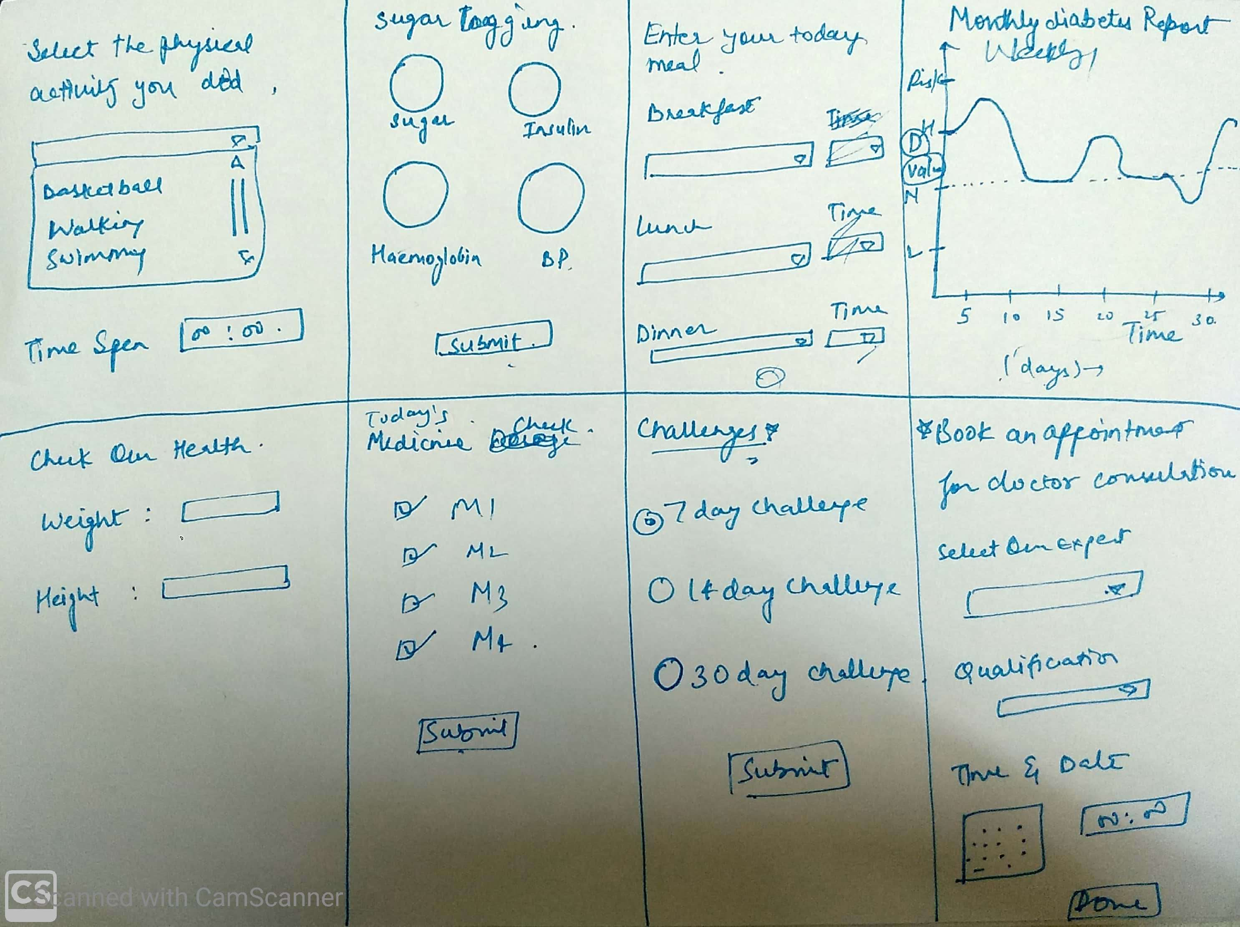
8 Sketches
Photo of your 8 sketches here

Slide 19
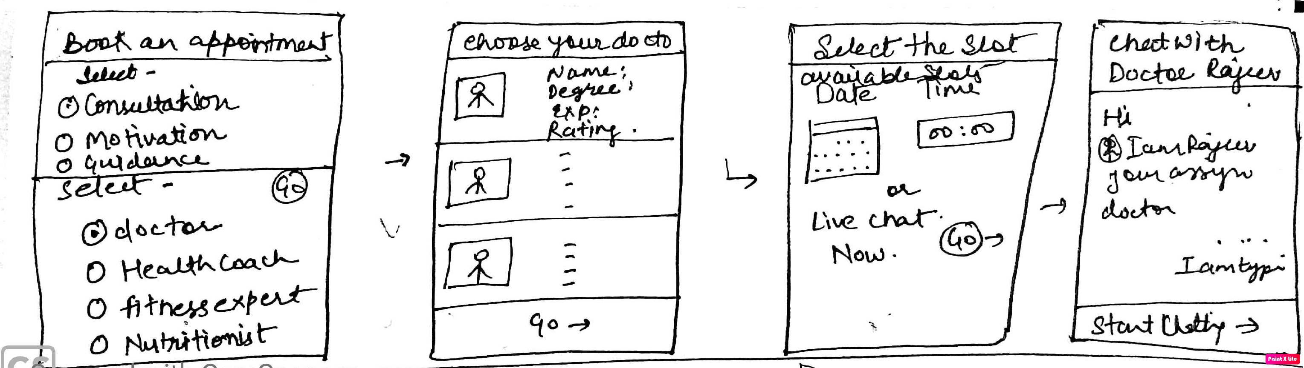
Solution Sketch 1- Consult Doctor
Upload a photo of your sketch on this slide

Slide 20
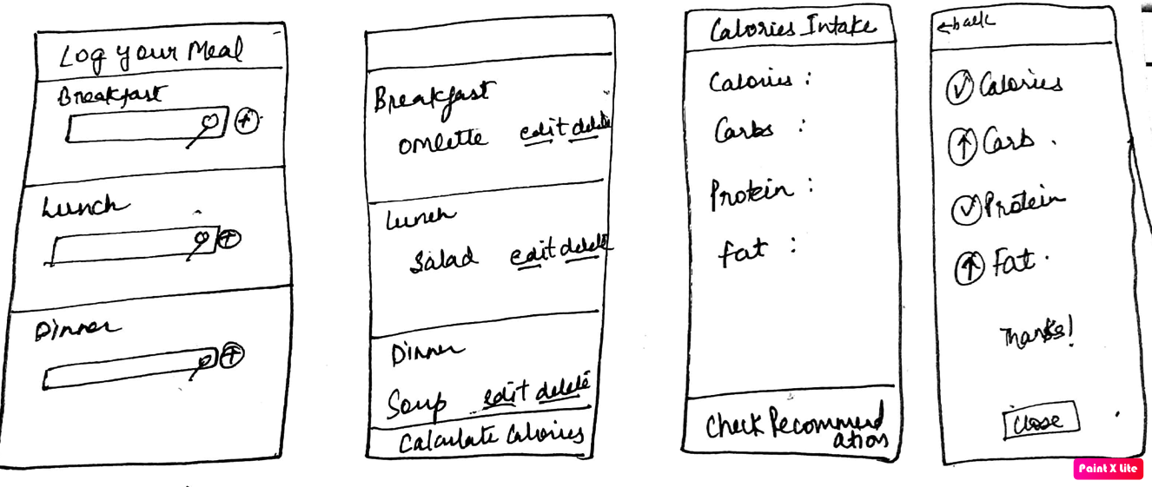
Solution Sketch 2- Tracking Diet
Upload a photo of your sketch on this slide

Slide 21
Decide
Pick the final concept that you develop into a prototype
© 2019 Udacity. All rights reserved.
Notes:
[ALL PARTICIPATION]

Slide 22
Decision
Decision | Consult with Doctor
Rationale | I have chosen this sketch because this is a very unique feature of our app which our competitor do not have. Patients can directly consult to the doctors online without much hassle of going to hospital for the consultation, therefore this feature will be our USP.

Slide 23
Prototype
Turn your concept into a realistic, interactive prototype that you will use to validate your assumptions and ideas
© 2019 Udacity. All rights reserved.
Notes:
[ALL PARTICIPATION]

Slide 24
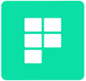
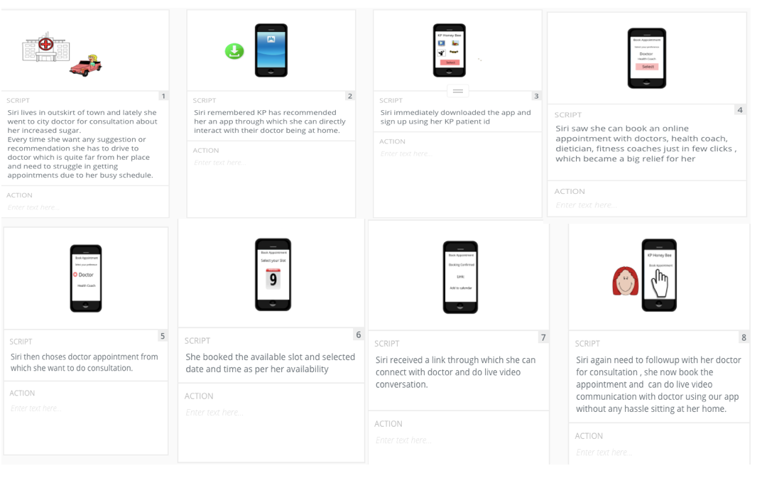
Storyboard
Link your plot
Upload your storyboard on this slide

Slide 25
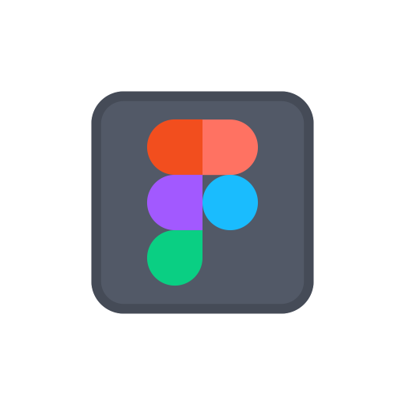
Prototype
Description High level overview of the prototype What does it do? | The Prototype enable patient to consult doctor through live interaction. The Patient can book live session or directly chat with doctor. In order to take live session , they need to book an appointment with doctor as well the available slot.
Assumptions Any assumptions within the prototype | I have assumed that the doctor which are available for live chat have enabled their profile for live chatting. I have assumed that the video link which patient has received on booking appointment will only be active on the booked slot and while clicking on the link doctor and patient can video chat For video and text chat and engineers has integrated third party tool for video/ text chatting
Tasks What are the tasks that a user can complete in the prototype? | User can book the appointment with doctor User can directly chat with the doctor.
Link your prototype

Slide 26
Validate
Users will go through your prototype and provide feedback on your concept. This is also an opportunity to have an engineering feasibility discussion
© 2019 Udacity. All rights reserved.
Notes:
[ALL PARTICIPATION]

Slide 27
Plan and recruit for research
Link your research plan

Slide 28

User Testing
Link your
notes
Link your audio recording
Key Findings from Participant 1
What worked well | User flow is very clear and intuitive Patient can interact with one of the either professionals doctor, health coach , dietician , fitness expert. Health care professional details and rating
Where participants got stuck | Patient got stuck while selecting date and time . They feel doctor might or might not available be at his given time due to which appointment may fail. Live chat option is later in the flow . It could be better if patient get to know they can chat with health care at the starting state.
Other observations | Patient was interested in customized recommendation according to his health and needs.

Slide 29
User Testing
Link your
notes
Link your audio recording
Key Findings from Participant 2
What worked well | 1)Patient really liked that they can book appointment with different health care professional like doctor, dietician , fitness expert as per their requirement. 2) Workflow is simple and intuitive 3) One to One conversation with health care simplified and easy to use.
Where participants got stuck | Patient feel difficulty while selecting date and time because if doctors is not available at patient selected date and time , it can be confusing.
Other observations | Improvement suggested by patient- They could be able to sort and select doctor as per their rating and qualification Show doctor’s available time slot to patient .

Slide 30
Improvements
Improvement #1 | Live chat option at Home Page
Rationale | I want to implement this in order to highlight this feature so that patient can solve their problem immediately without any ambiguity.
Improvement #2 | Doctor available time will be shown as available slot so that patient can select date and time which is per both convenience.
Rationale | I have selected this improvement to increase the user experience as we need to give patient the appropriate time slot and best experience.

Slide 31
Feasibility
 | Your Assumptions | Specific feasibility questions
Drawing the UI What data is needed to draw the UI on the screen? Where is the data coming from | Doctor availability date and time. Data will be coming from our database | Is it feasible to change the doctor availability time frequently?
User generated data Is it stored? Where/how? How wll that data be used again? | Yes, it is stored in our database.. We can use it again for report generation as well as for customized recommendations | How much old data of a user can be save ? Can we get 1 year back reports of patient?
Latency How quickly should things load? Are there any operations that might slow down load time (ie: a call to another service)? | Load time: 2-3sec It might if we use any api’s else not. Video and chat interface integration | Do we need to use any api’s ? What happens if video platform is not responding?

Slide 32
Iterate
Leverage learnings from your first two user interviews to make changes to your prototype. Then run another round of user interviews.
© 2019 Udacity. All rights reserved.
Notes:
[ALL PARTICIPATION]

Slide 33
Prototype v2
Description High level overview of the prototype What does it do? | The prototype is designed for patients to perform live chat and book appointment for video conferencing. Thereafter they will be provided a link to do video chat at their selected time.
Assumptions Any assumptions within the prototype | The assumption is doctors available time might change and we will update it accordingly. Video and chatting platform will be up running all the time.
Tasks What are the tasks that a user can complete in the prototype? | The Task that a user can complete in a prototype are- Live chatting with doctor/health care/ dietician / fitness expert Video chat with health care professional.
Link your prototype v2

Slide 34
User Testing Round 2
Link your
notes
Link your audio recording
Key Findings from Participant 3
What worked well | 1) Reliable solution for patient to treat diabetes 2) Saves a lot of time of patient as they do not have to go doctor every other time. 3) Layout and design is clean and easy to use.
Where participants got stuck | User was doubtful while selecting doctor if the doctor is not unavailable , they should notify user.
Other observations | The patients who are already seeing their regular doctor they feel comfortable and more dependent on their own doctor and wish to see their own doctor on app.

Slide 35
Handoff
© 2019 Udacity. All rights reserved.
Notes:
[ALL PARTICIPATION]

Slide 36
Updated PRD
Link your PRD

